Slide 1
Switching Circuits

Slide 2
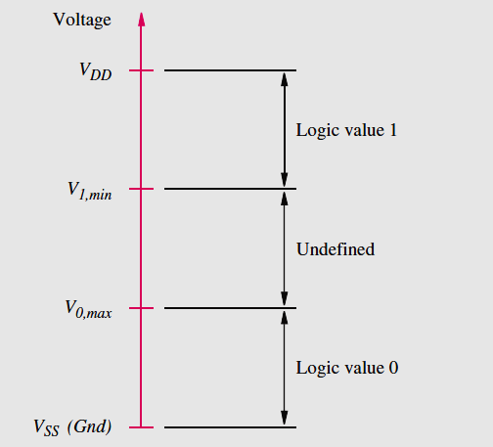
Representation of logic values by voltage levels
Minimum voltage is VSS (Gnd), maximum voltage is VDD (supply). The voltages in the range Gnd to V_{0, max} represent logic value 0. V_{0, max} is the maximum voltage level that a logic circuit must recognize as low. Similarly, the range from V_{1, min} to VDD corresponds to logic value 1, and V_{1, min} is the minimum voltage level that a logic circuit must interpret as high.

Slide 3
Transistor Switches
Logic circuits are built with transistors.
The most popular type of transistor for implementing the switch is the metal oxide semiconductor field-effect transistor (MOSFET).
Two different types of MOSFET are:
n-channel (NMOS)
p-channel (PMOS)

Slide 4
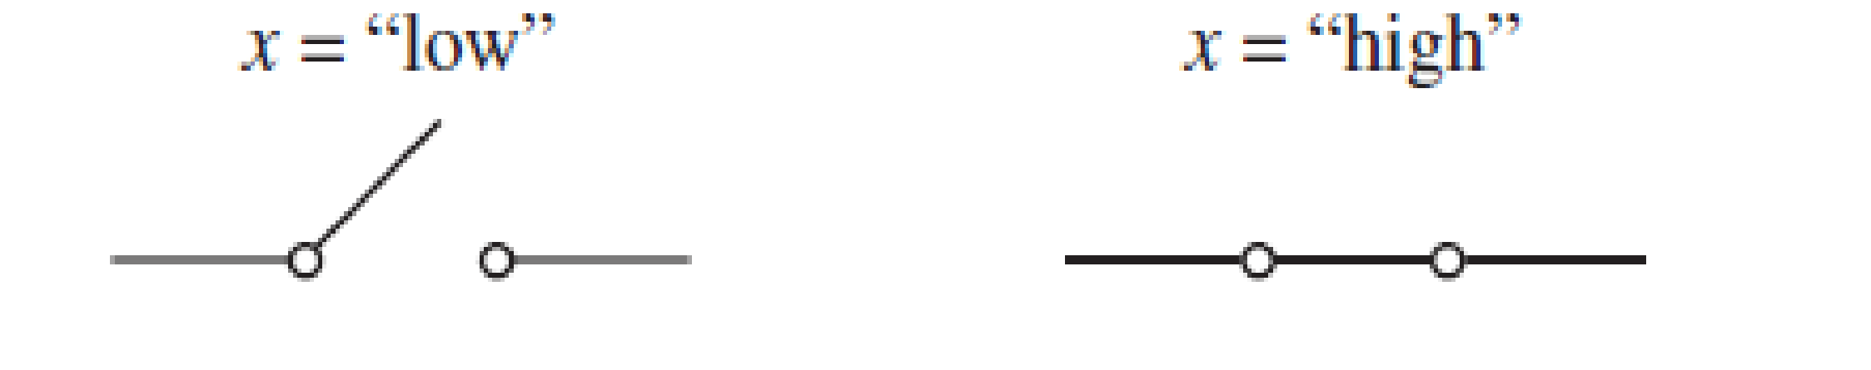
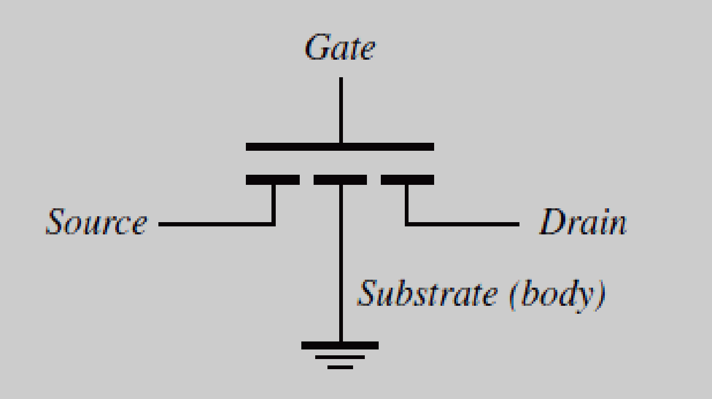
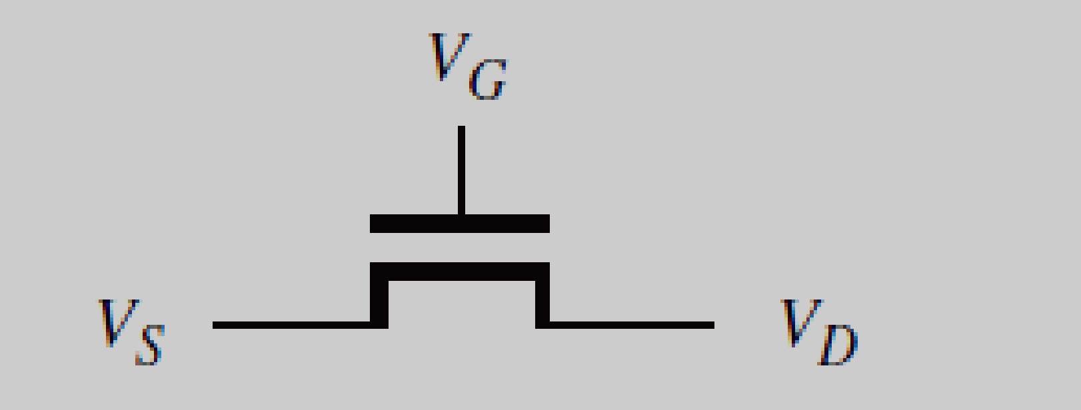
NMOS Transistor
Simplified symbol for an NMOS Trnsistor

Slide 5
NMOS transistor has four electrical terminals, called the source, drain, gate, and substrate. In logic circuits the substrate (also called body) terminal is connected to Gnd. So the simplified graphical symbol which omits the substrate node is used. The source and drain terminals are distinguished in practice by the voltage levels applied to the transistor; by convention, the terminal with the lower voltage level is deemed to be the source.

Slide 6
If Vg is low, then there is no connection between the source and drain, transistor is turned off.
If Vg is high then the transistor is turned on and act as a closed switch that connects source and drain terminals.

Slide 7
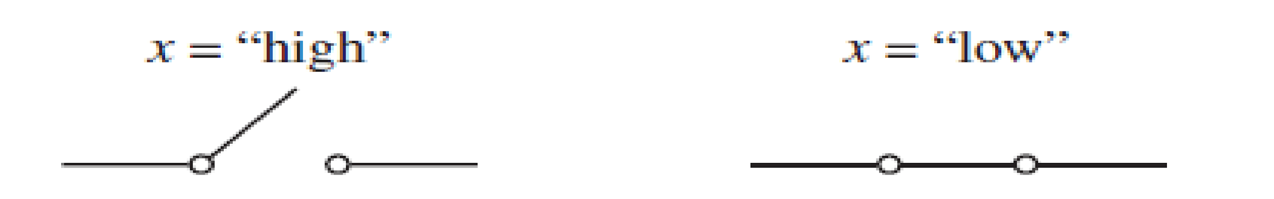
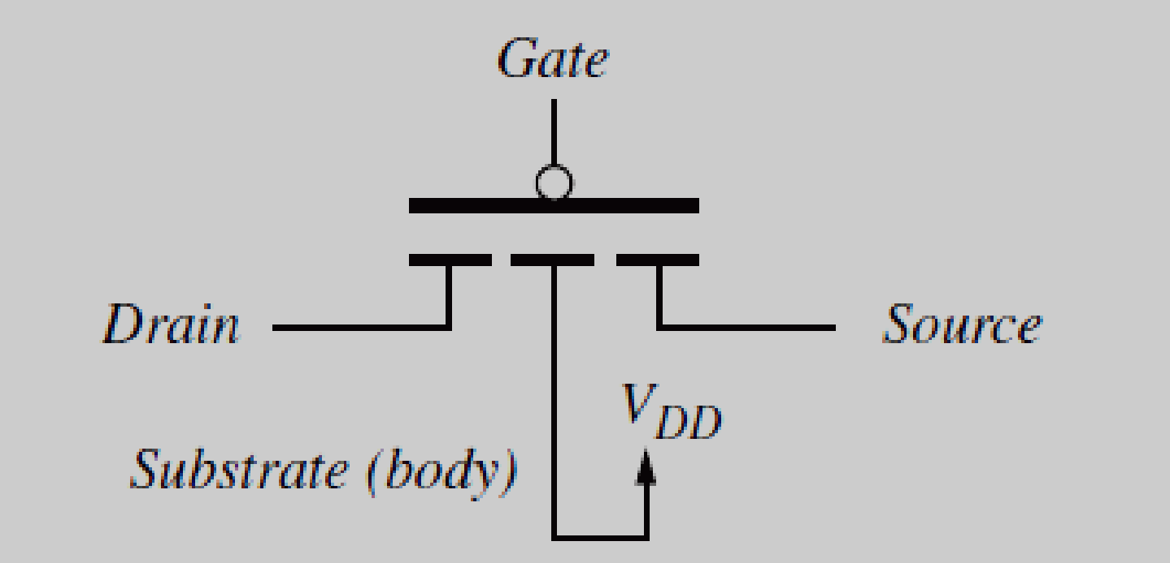
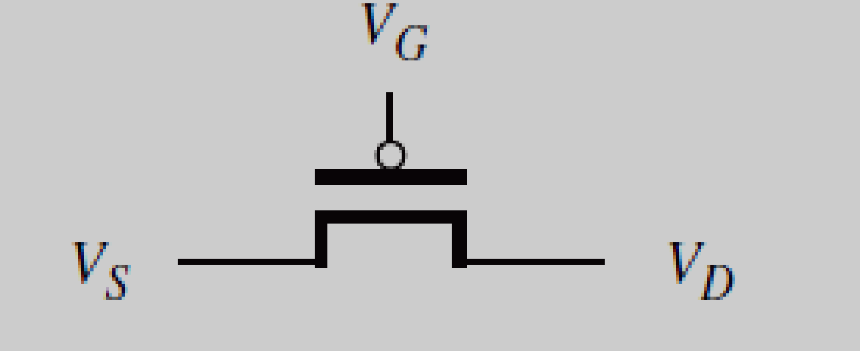
PMOS Transistor

Slide 8
In logic circuits, the substrate of the PMOS transistor is always connected to VDD.
If Vg is high, then the transistor is turned off and acts like a open switch.
If Vg is low, then the transistor is turned on and act as a closed switch that connects source and drain terminals.
In the PMOS transistor the source is the node with the higher voltage.

Slide 9
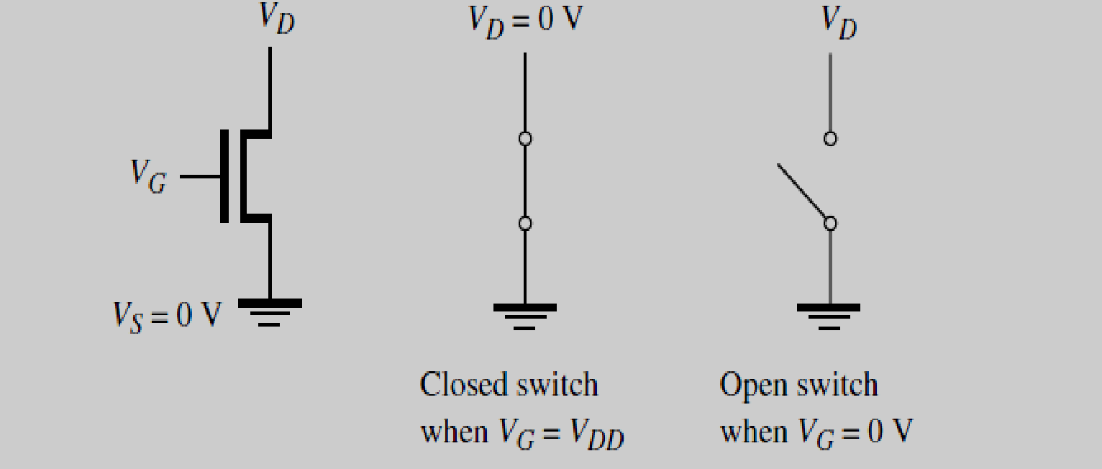
When the NMOS Transistor is turned on, its drain is pulled down to Gnd.

Slide 10
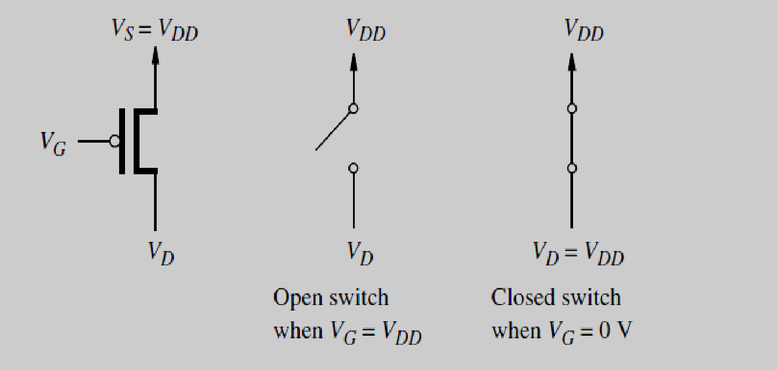
When the PMOS Transistor is turned on, its drain is pulled up to V_{DD}.

Slide 11
CMOS Logic Gates
The most popular approach that uses both NMOS and PMOS transistors together is the CMOS Technology.
In NMOS circuits the logic functions are realized by arrangements of NMOS transistors, combined with a pull-up device that acts as a resistor.

Slide 12
The part of the circuit that involves NMOS transistors is called the pull-down network(PDN).
In CMOS, pull-up device is replaced with a pull-up network (PUN) that is built using PMOS transistors, such that functions realized by the PDN and PUN networks are complements of each other.

Slide 13
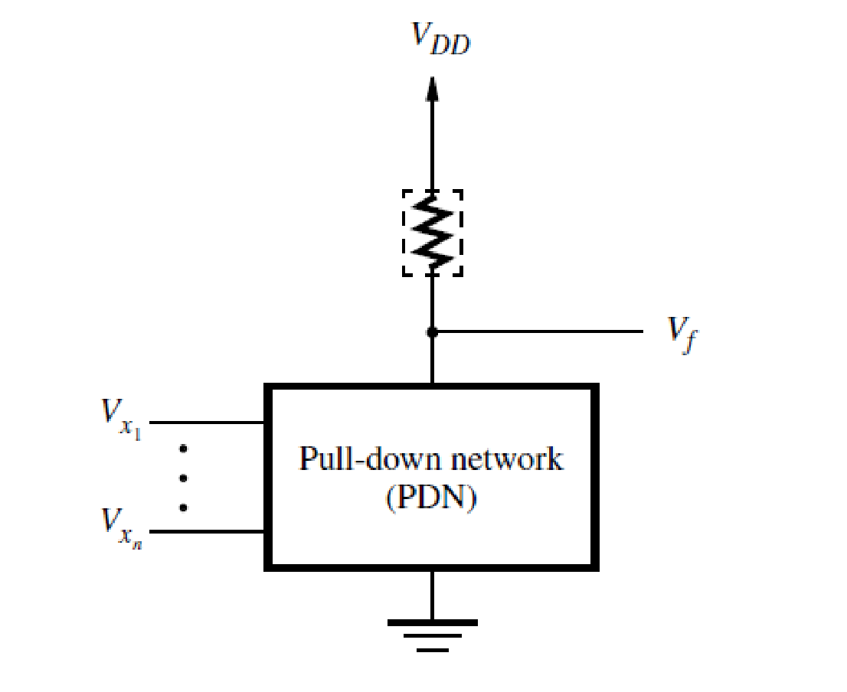
Structure of a NMOS circuit

Slide 14
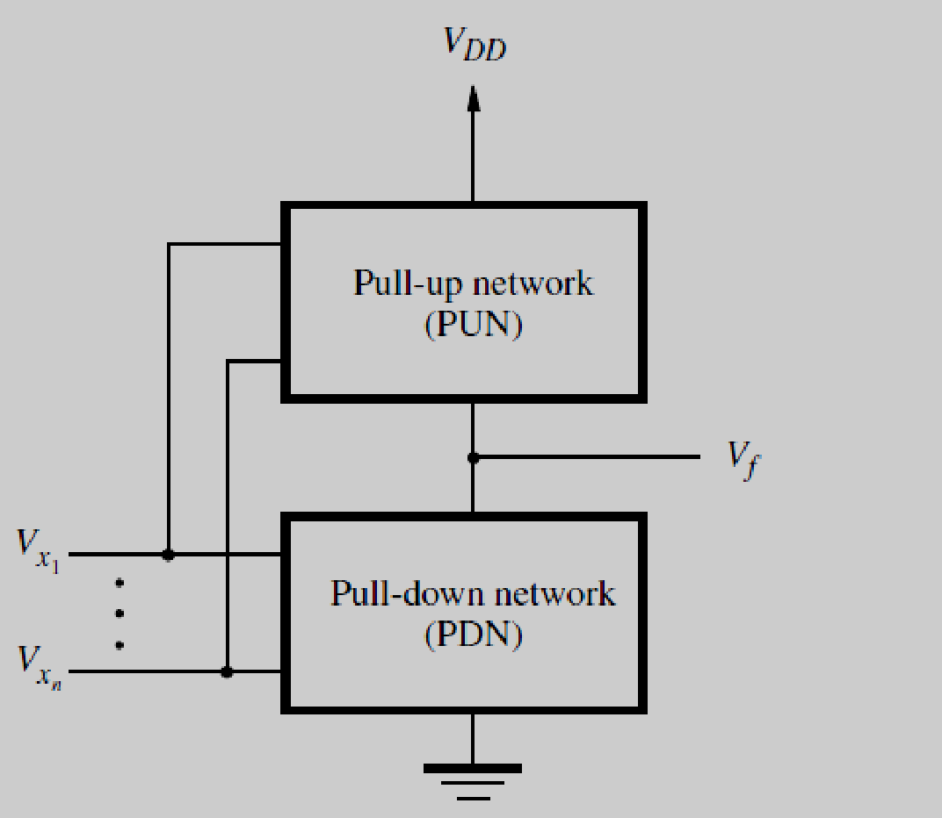
Structure of a CMOS circuit

Slide 15
For any given valuation of the input signals, either the PDN pulls Vf down to Gnd or the PUN pulls Vf up to V_{DD.}

Slide 16
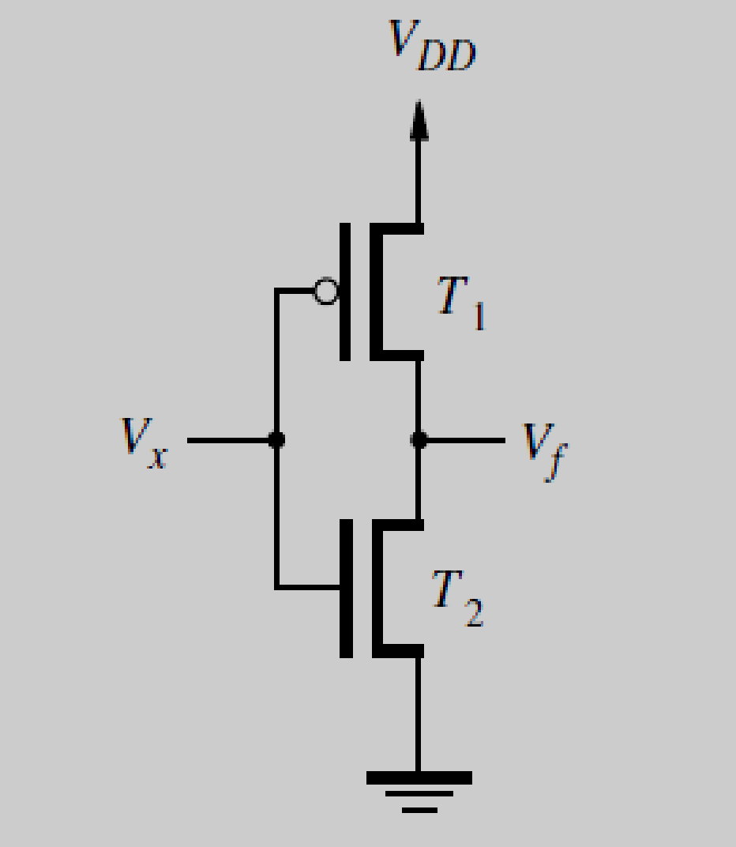
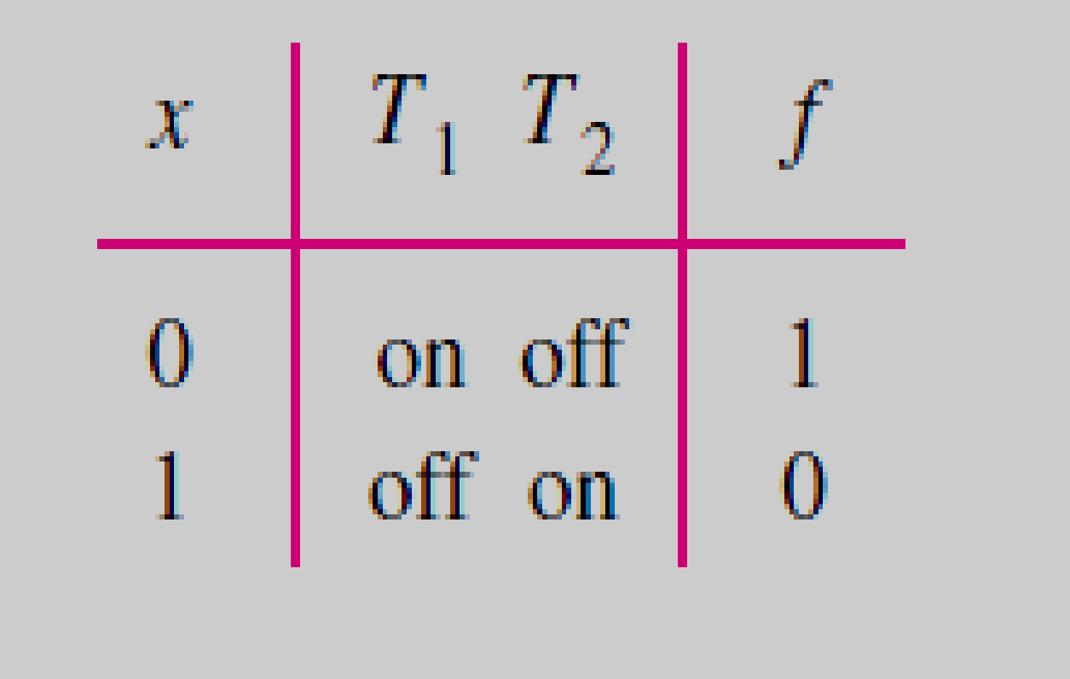
CMOS realization of a NOT Gate

Slide 17
When Vx=0V, then transistor T2 is off and transistor T1 is on. This makes Vf=5V and since T2 is off no current flows through transistors.
When Vx=5V, T2 is on and T1 is off. Thus
Vf =0V, and no current flows because T1 is off.

Slide 18
No current flows in all CMOS circuits when the input is either low or high.
No power dissipated under steady state conditions.

Slide 19
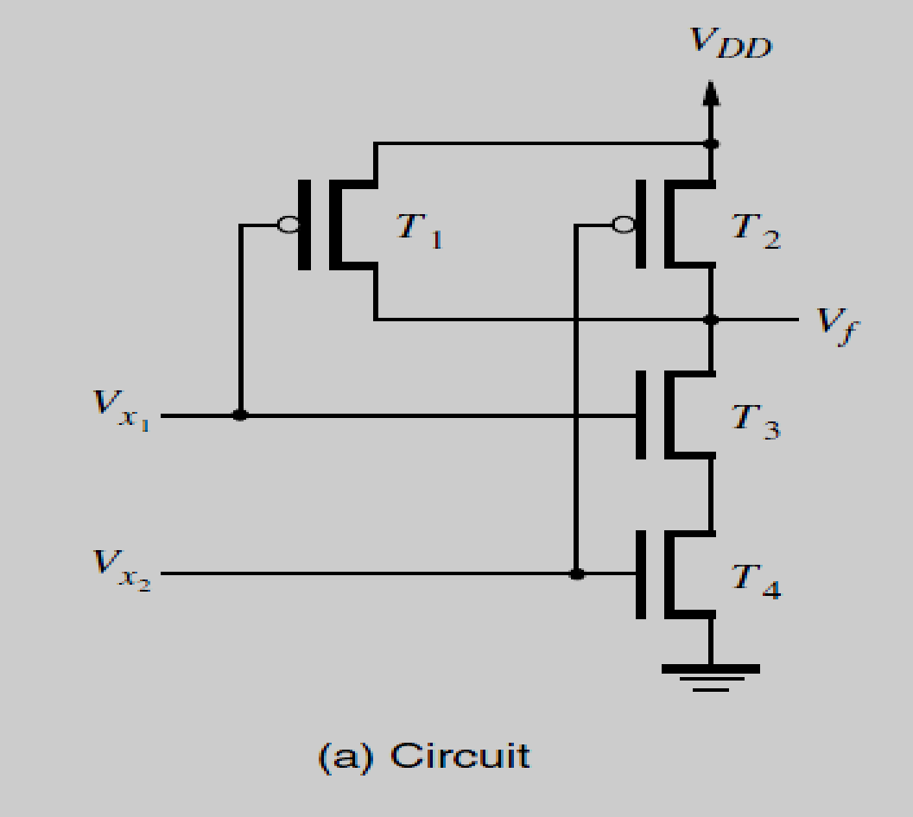
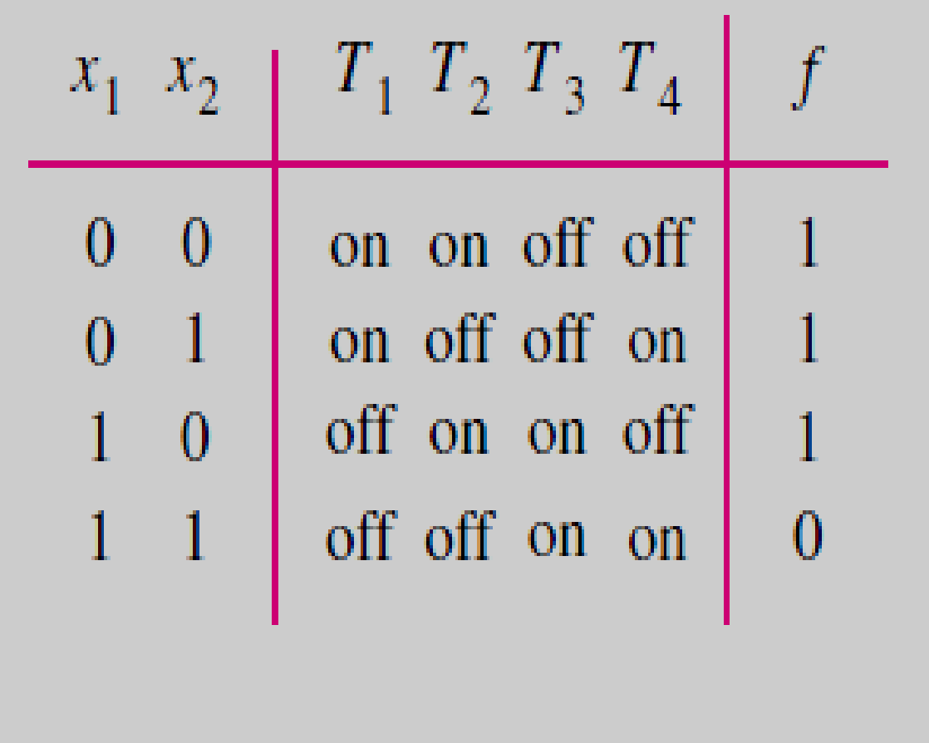
CMOS realization of a NAND Gate

Slide 20
NAND operation, f=(x1x2)’ = x1’ + x2’
The above expression specifies the condition for which f=1; hence it defines PUN.
In PUN an input variable xi turn on a transistor if xi=0.
Thus f=1 when either input x1 or x2 has the value 0, which means PUN must have 2 PMOS transistors connected in parallel.

Slide 21
The PDN must implement complement of f,
f’ = x1x2
Since f’ is 1 when both x1 and x2 are 1, it follows that PDN must have 2 NMOS transistors connected in series.

Slide 22
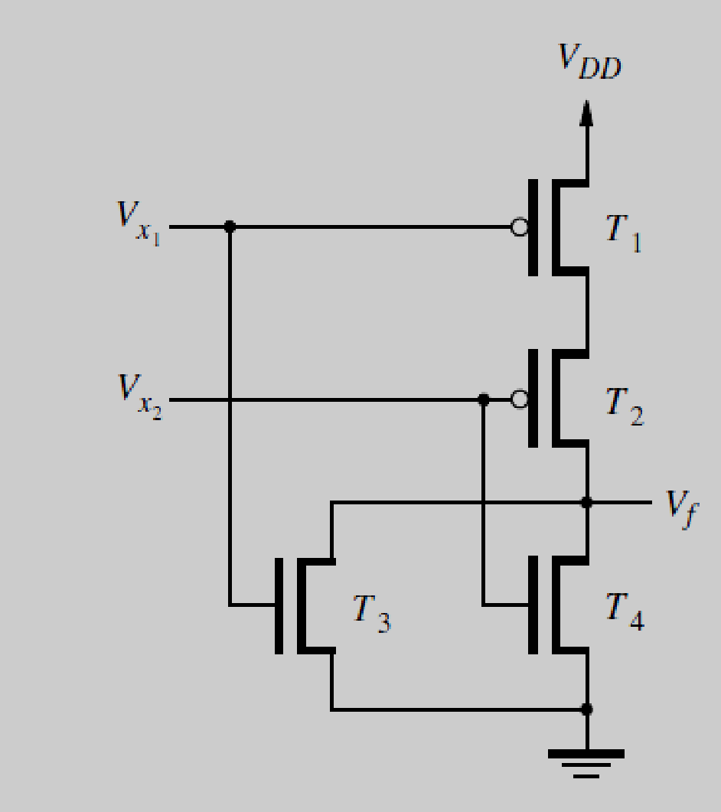
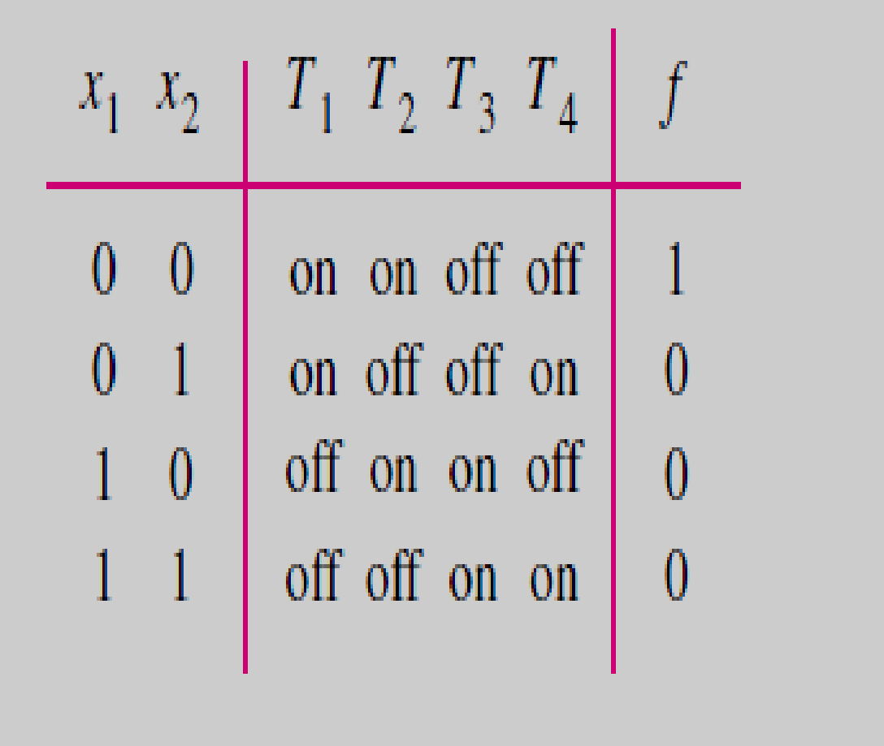
CMOS realization of a NOR Gate

Slide 23
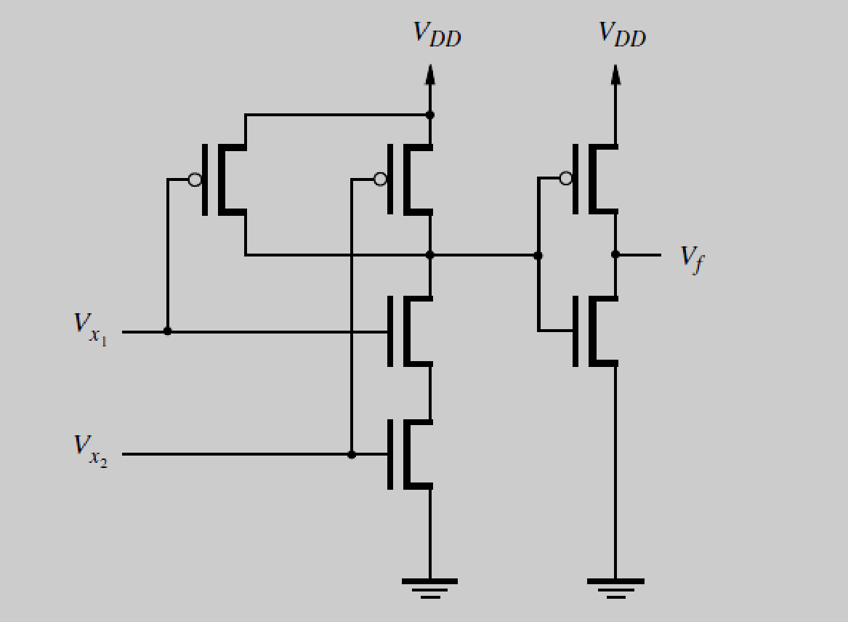
CMOS AND gate
CMOS AND gate is built by connecting a NAND gate to an inverter.

Slide 24
Programmable Logic Devices
It is possible to manufacture chips that contain relatively large amounts of logic circuitry with a structure that is not fixed. Such chips are called programmable logic devices (PLDs). Two main types of PLDs are Programmable Logic Array (PLA) and Programmable Array Logic (PAL).

Slide 25
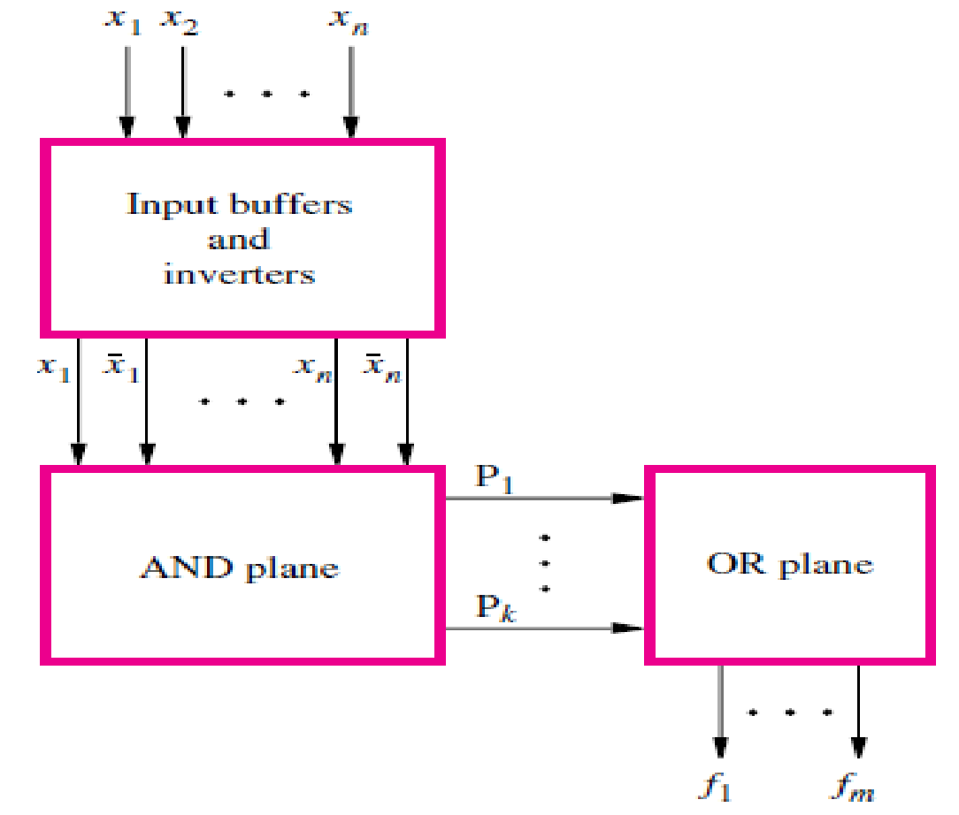
Programmable Logic Array (PLA)
A PLA comprises a collection of AND gates that feeds a set of OR gates.

Slide 26
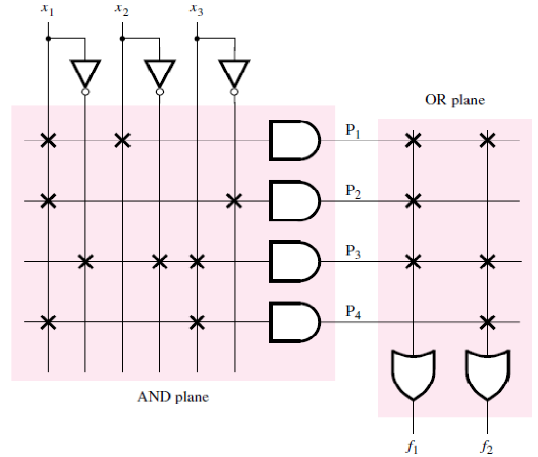
f1 = x1x2 + x1x3’ + x1’x2’x3.
f2 = x1x2+x1’x2’x3+x1x3.

Slide 27
Example: Implement using PLA
F1(A,B,C)=∑m(0,1,6,7)
F2(A,B,C)=∑m(2,3,4,5)

Slide 28
Programmable Array Logic (PAL)
The PLAs are hard to fabricate and the speed-performance of circuits implemented in the PLAs are reduced because both AND and OR planes are programmable. These drawbacks led to the development of a similar device in which the AND plane is programmable, but the OR plane is fixed. Such a chip is known as a programmable array logic (PAL). They are simpler to manufacture, and thus less expensive than PLAs, and offer better performance.

Slide 29
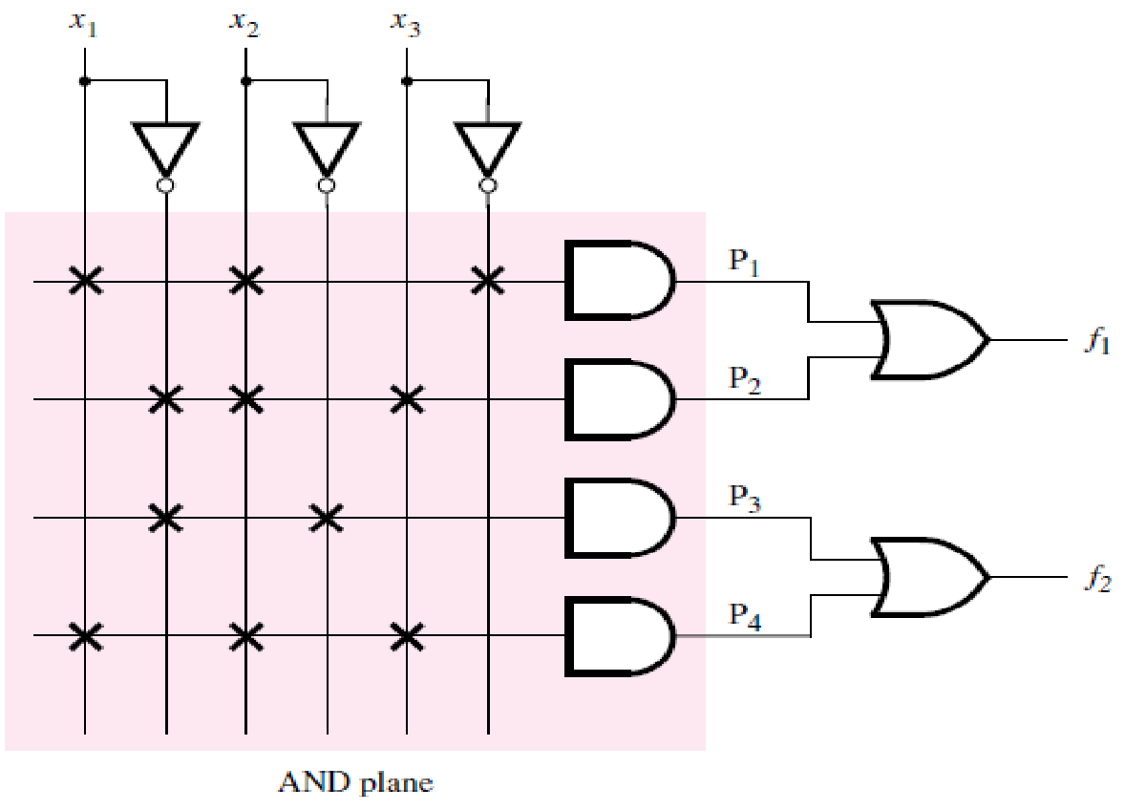
An example of a PAL with three inputs, four product terms, and two outputs :
f1 = x1x2x3’ +x1’x2x3
f2 = x1’x2 +x1x2x3.

Slide 30
Example: Implement using PAL
F1(A,B,C)=∑m(0,1,6,7)
F2(A,B,C)=∑m(2,3,4,5)

Slide 31
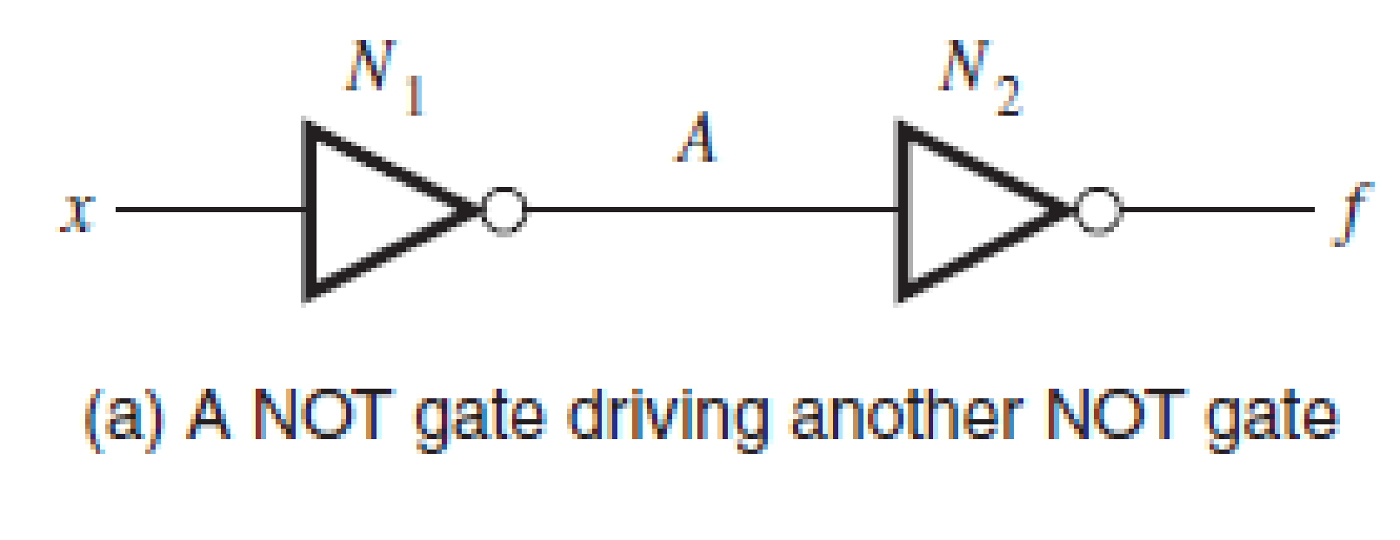
Noise Margin:
Electronic circuits are constantly subjected to random perturbations, called noise, which can alter the output voltage levels produced by the gate N1.
It is essential that this noise not cause the gate N2 to misinterpret a low logic value as a high one, or vice versa.
Consider the case where N1 produces its low voltage level VOL. The presence of noise may alter the voltage level, but as long as it remains less than VIL, it will be interpreted correctly by N2.

Slide 32
The ability to tolerate noise without affecting the correct operation of the circuit is known as noise margin. For the low output voltage, we define the low noise margin as
NML = VIL − VOL
A similar situation exists when N1 produces its high output voltage VOH. Any existing noise in the circuit may alter the voltage level, but it will be interpreted correctly by N2 as long as the voltage is greater than VIH. The high noise margin is defined as
NMH = VOH – VIH

Slide 33
Fan in and Fan out:
The fan-in of a logic gate is defined as the number of inputs to the gate. Depending on how a logic gate is constructed, it may be impractical to increase the number of inputs beyond a small value.
In real circuits each logic gate may be required to drive several others. The number of other gates that a specific gate drives is called its fan-out.

Slide 34
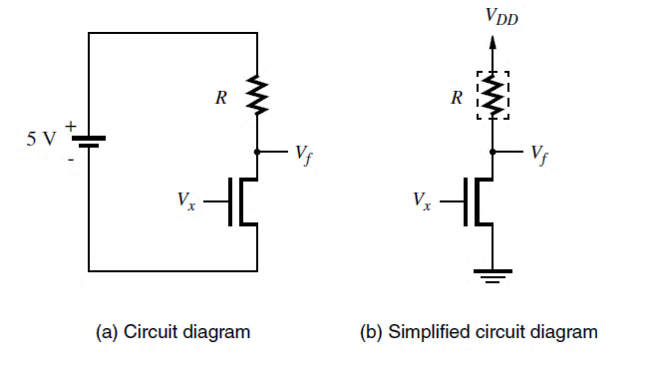
Power Dissipation in Logic Gates
Consider the NMOS inverter shown below:
When Vx = 0, no current flows and hence no power is used. But when Vx = 5 V, power is consumed because of the current flowing through the transistor.

Slide 35
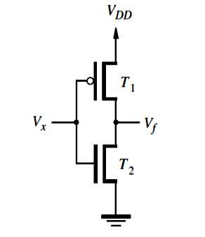
Consider the CMOS inverter shown below:
When the input Vx is low, no current flows because the NMOS transistor is off. When Vx is high, the PMOS transistor is off and again no current flows. Hence no current flows in a CMOS circuit under steady-state conditions. Current does flow in CMOS circuits, however, for a short time when signals change from one voltage level to another.

Slide 36
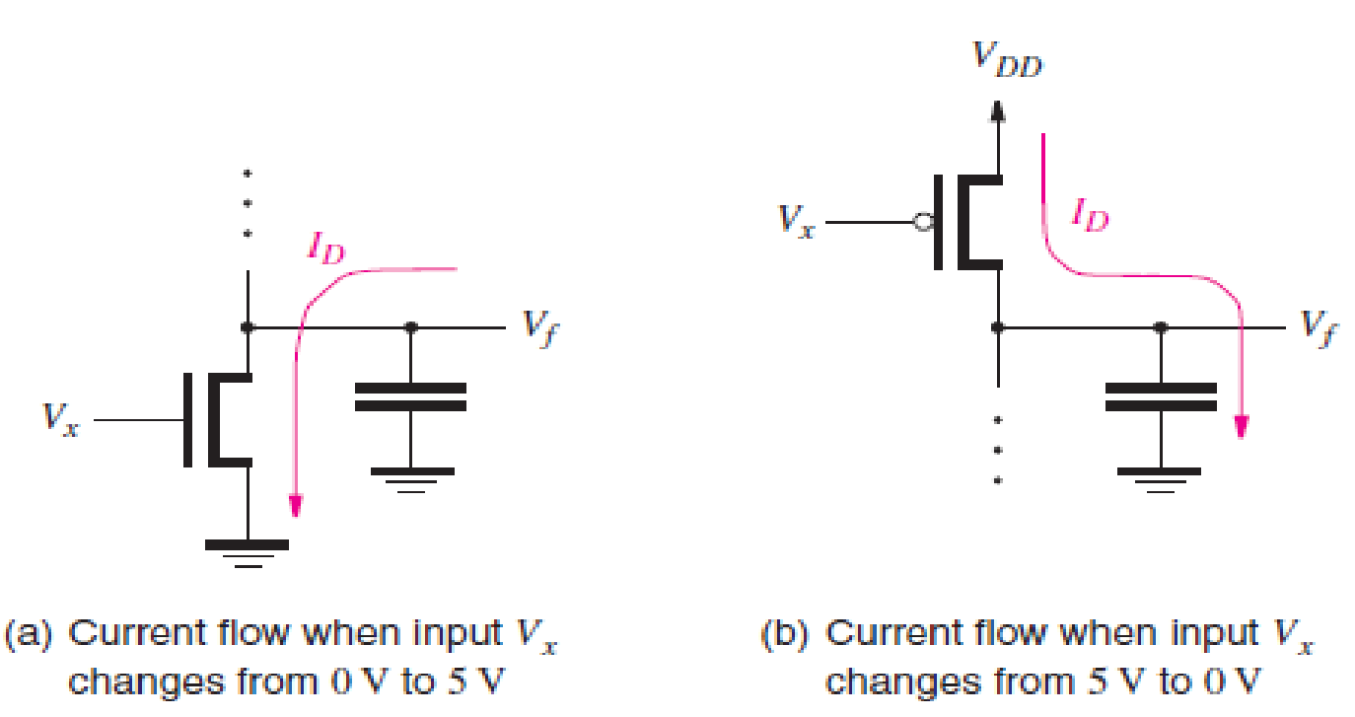
Static Power : power dissipated by the current that flows in the steady state
Dynamic Power: power dissipated when the current flows because of changes in signal levels.
NMOS circuits consume static power as well as dynamic power, while CMOS circuits consume mostly dynamic power.

Slide 37
Consider the situation in Figure (a) when V_{f} = VDD. The amount of energy stored in the capacitor is equal to CV_{DD}² /2. When the capacitor is discharged to 0 V, this stored energy is dissipated in the NMOS transistor.
Similarly, for the situation in Figure (b), the energy CV_{DD}² /2 is dissipated in the PMOS transistor when C is charged up to V_{DD}. Thus for each cycle in which the inverter charges and discharges C, the amount of energy dissipated is equal to CV_{DD}².
Since power is defined as energy used per unit time, the power dissipated in the inverter is the product of the energy used in one discharge/charge cycle and the number of such cycles per second, f. Hence the dynamic power consumed is
P_{D} = f CV_{DD}²

Slide 38
Buffers
A Buffer is a logic gate with one input x and one output f which produces f=x.
The simplest implementation uses two inverters.
Buffers are used for driving higher than normal capacitive loads.

Slide 39
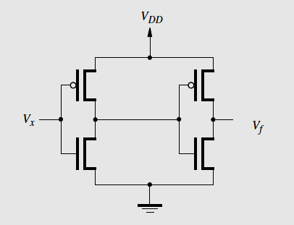
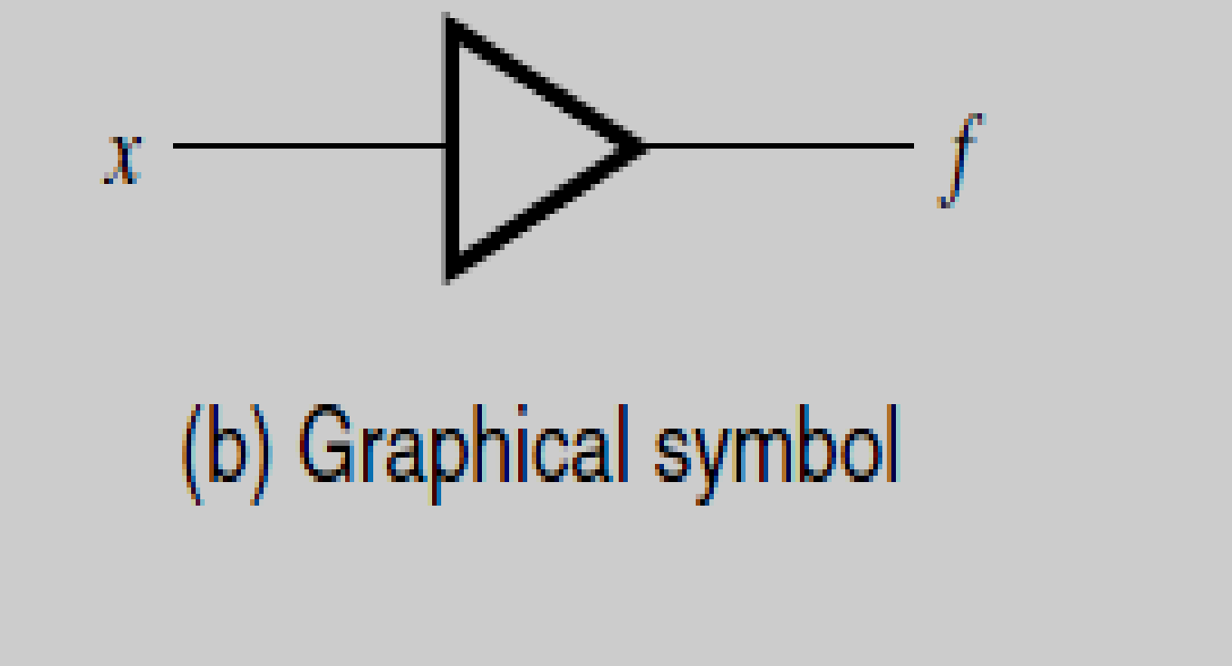
Non-inverting Buffers

Slide 40
Inverting Buffer
It produces same output as an inverter, f=x’ but built with large transistors.
Buffers can handle relatively large amounts of current flow because they are built with large transistors.
The graphical symbol for the inverting buffer is the same as for the NOT gate; an inverting buffer is just a NOT gate that is capable of driving large capacitive loads.

Slide 41
Tri-state Buffers
A tri-state buffer has one input x, one output f and a control input called enable e.
The enable input is used to determine whether or not the tri-state buffer produces an output signal.
When e=0, the buffer is completely disconnected from the output f. When e=1 the buffer drives the value of x onto f causing f=x.

Slide 42
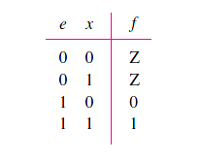
When e = 0, the output is denoted by the logic value Z, which is called the high-impedance state.
The name tri-state derives from the fact that there are two normal states for a logic signal 0 and 1 and Z represents a third state that produces no output signal.

Slide 43
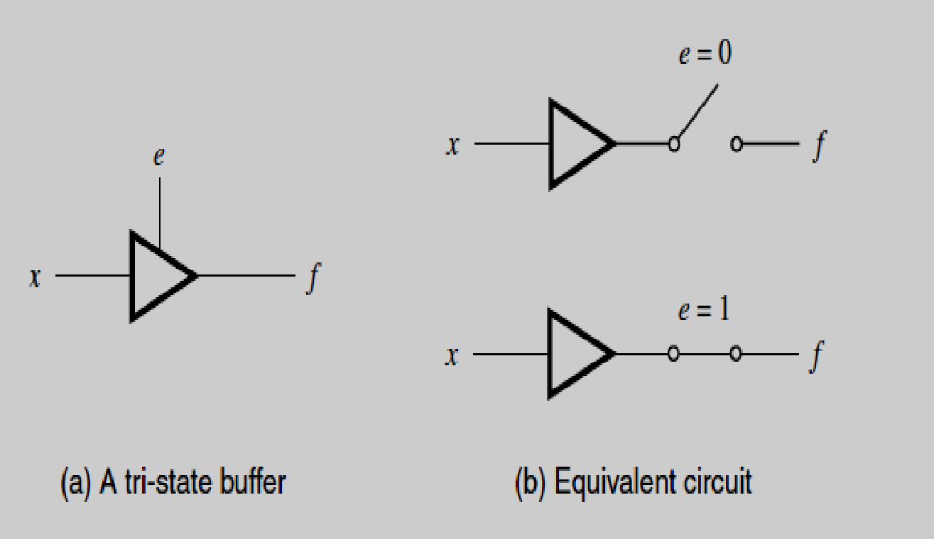

Slide 44
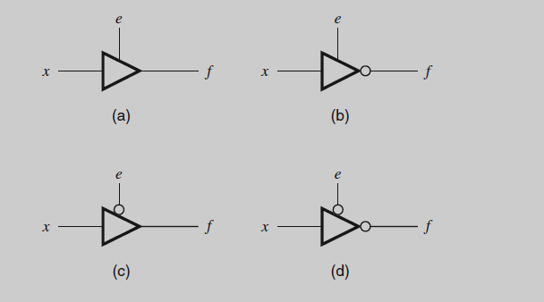
Four Types of tri-state buffers

Slide 45
Four Types of tri-state buffers
The buffer in part(b) has the same behavior as the buffer in part (a) except when e=1, it produces f=x’.
Part(c) is a tri-state buffer for which the enable signal has the opposite behavior, when e=0, f=x and when e=1, f=Z. (enable is active low)
Part(d) has an active-low enable and it produces f=x’ when e=0.

Slide 46
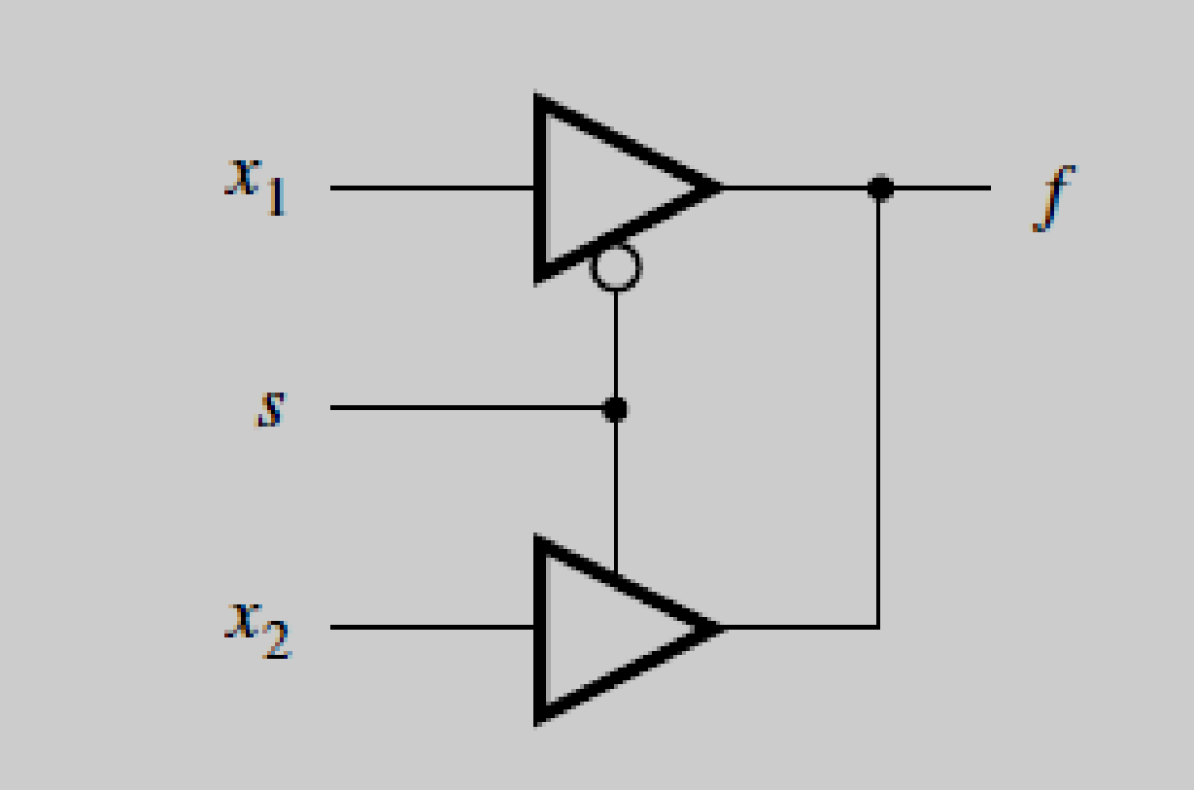
Application of tri-state buffers
In this circuit the output f is equal to either x1 or x2 depending on the value of s. When s=0, f=x1 and when s=1 f=x2. This is a multiplexer circuit.
In this circuit, the outputs of the tri-state buffers are wired together. This connection is possible because the control input s is connected so that one of the two buffers is guaranteed to be in the high-impedance state.

Slide 47
The x1 buffer is active only when s = 0, and the x2 buffer is active only when s = 1.
It would be disastrous to allow both buffers to be active at the same time. Doing so would create a short circuit between VDD and Gnd as soon as the two buffers produce different values.
For example, assume that x1 = 1 and x2 = 0. The x1 buffer produces the output VDD, and the x2 buffer produces Gnd. A short circuit is formed between VDD and Gnd, through the transistors in the tri-state buffers.
The kind of wired connection used for the tri-state buffers is not possible with ordinary logic gates, because their outputs are always active; hence a short circuit would occur.

Slide 48
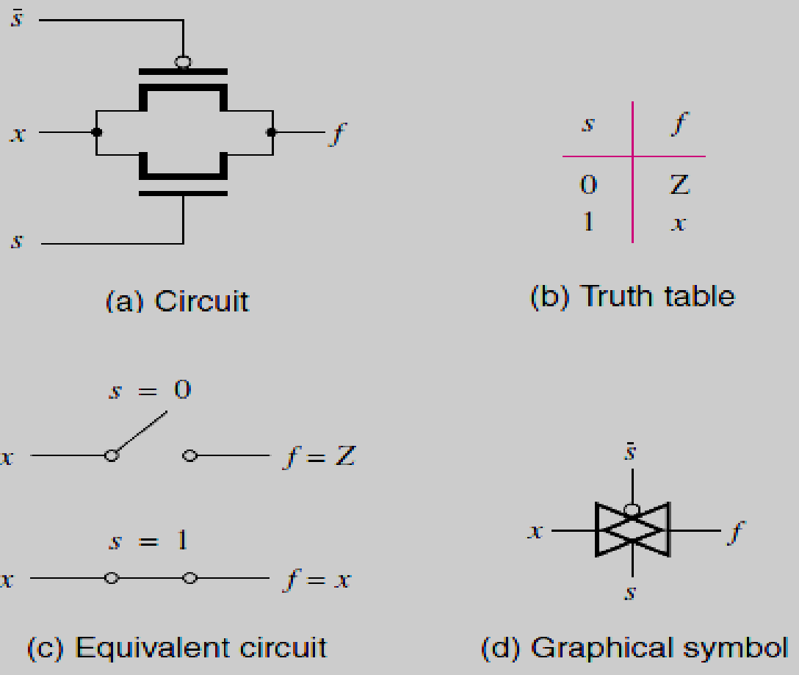
Transmission Gates
It is possible to combine an NMOS and a PMOS transistor into a single switch that is capable of driving its output terminal either to a low or high voltage

Slide 49
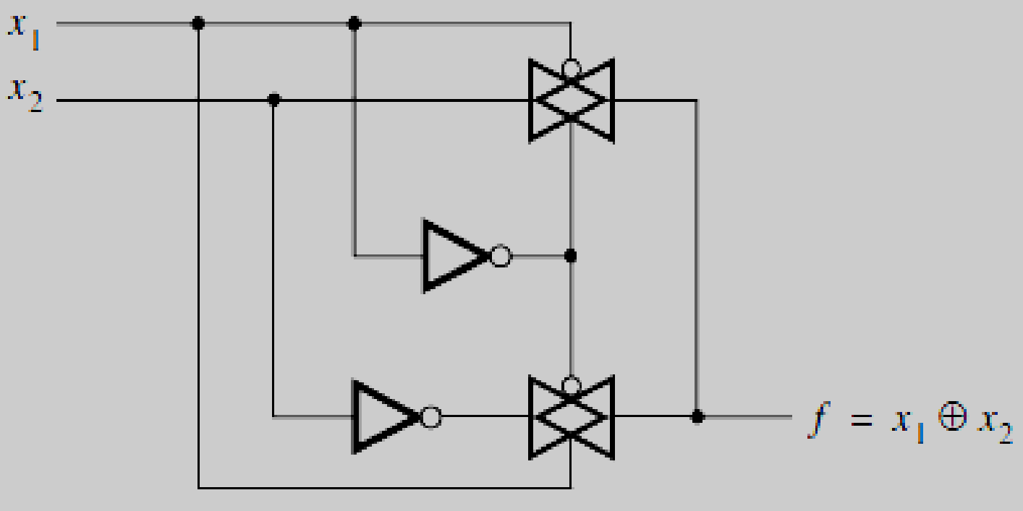
Applications of Transmission gates
Exclusive-OR Gates
The output f is set to the value of x2 when x1 = 0 by the top transmission gate. The bottom transmission gate sets f to x2’ when x1 = 1.

Slide 50
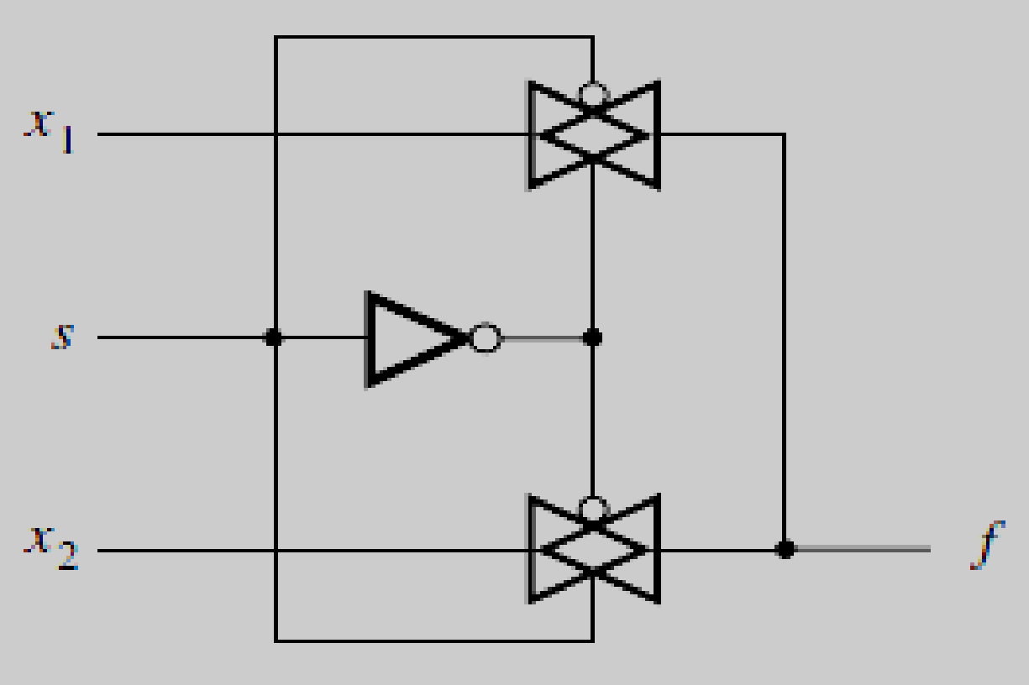
Multiplexer Circuit
The select input s is used to choose whether the output f should have the value of input x1 or x2. If s = 0, then f = x1; if s = 1, then f = x2.

